Slide 1

Revisiting the FUSE Data Archive - Finding O-VI
Maxwell Rizzo
Advisor: Dr. Haeun Chung
ASPERA mission, PI: Dr. Carlos Vargas
NASA Arizona April 2023 Symposium

Slide 2
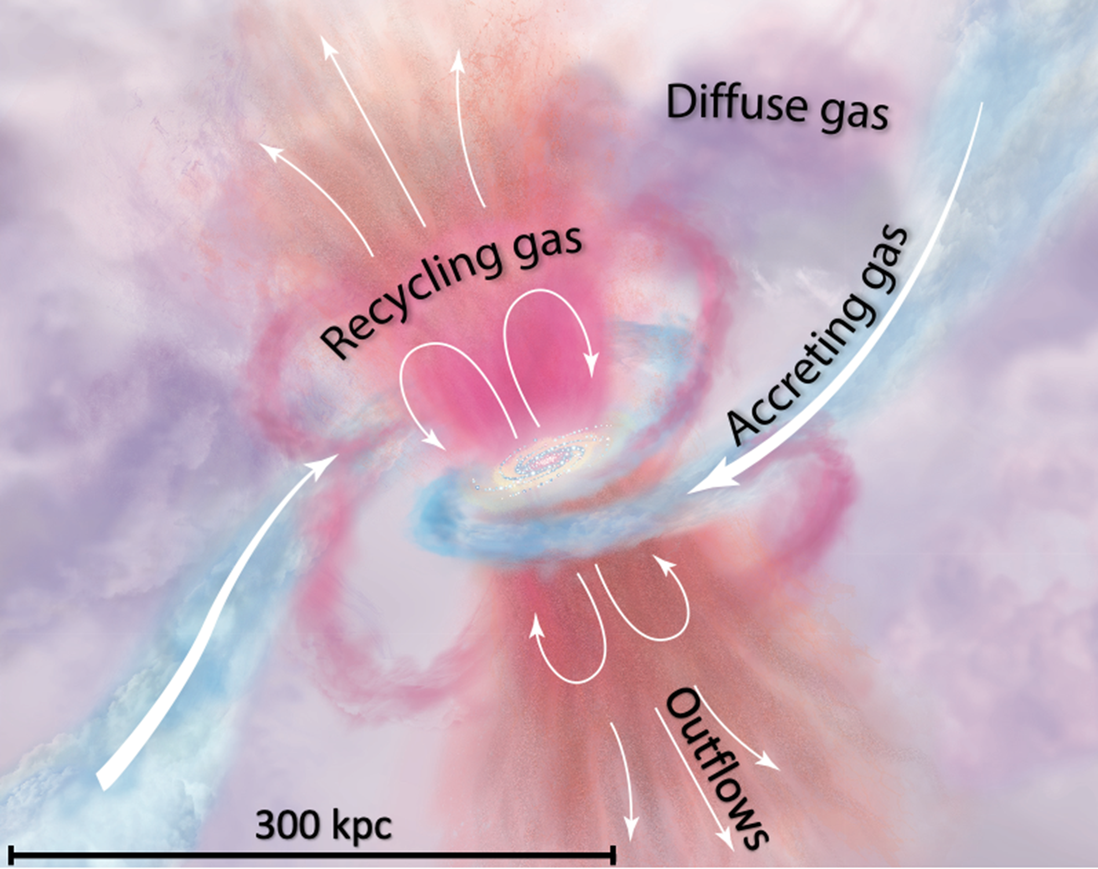
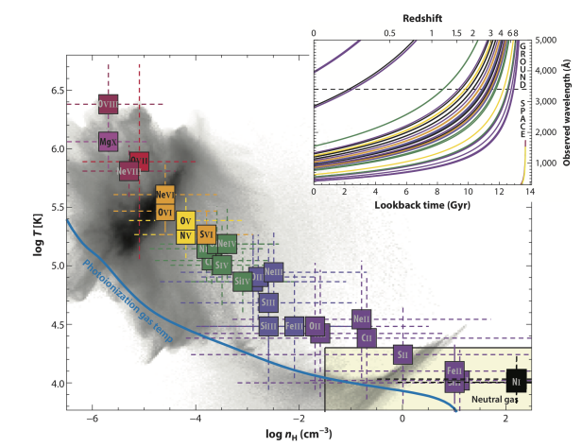
Circumgalactic Medium (CGM)
Largest component of galactic Baryonic Matter or visible Matter.
Reservoir for star-forming fuel.
Venue for stellar feedback and recycling.
Many phases present (Ranges 10^2-10^7 K).
Rich Dynamics, Complicated states.
Inherently difficult to observe (diffuse).
Many different factors make O-VI the best emission line to observe the CGM.
Tumlinson et al. (2017)

Slide 3
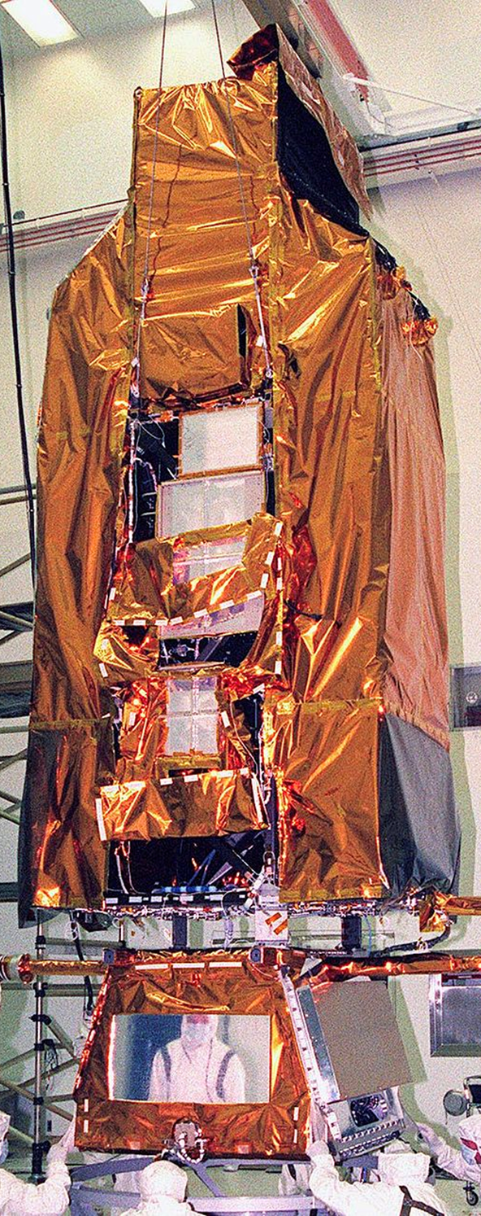
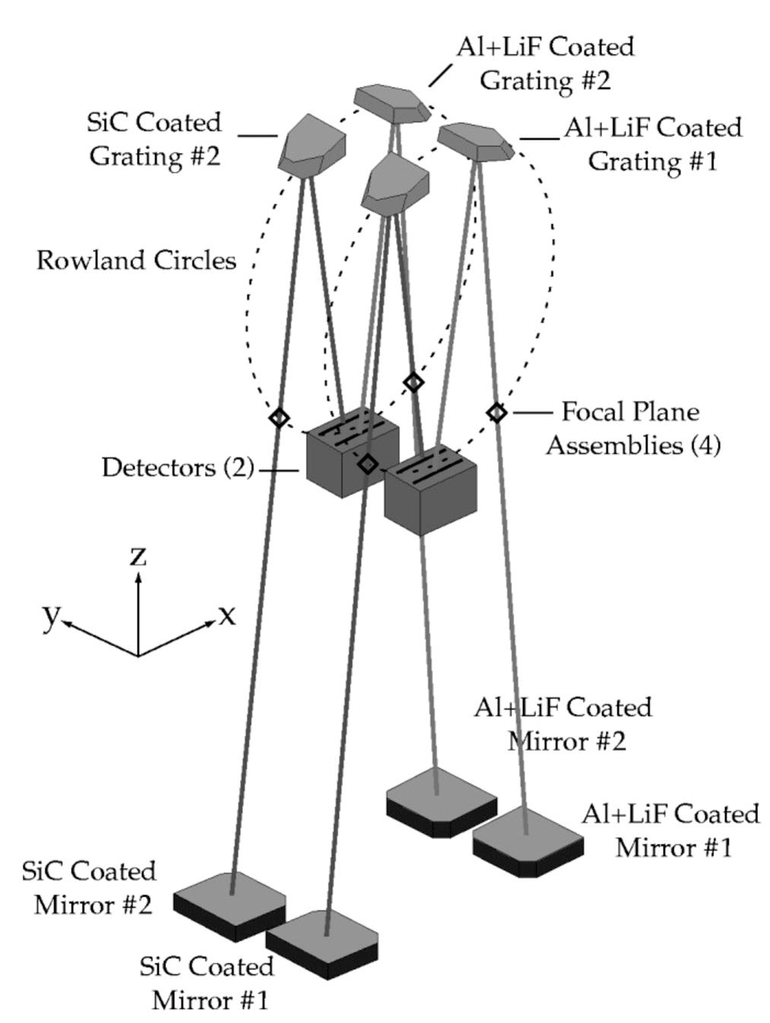
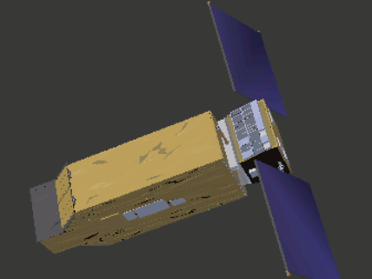
Far Ultraviolet Spectroscopic Explorer (FUSE) 1999-2007:
High resolution, wide field FUV spectrograph.
Functional range of ~90-120 nm, with four slits.
Wavelength range covers hot gas in galaxies, as well as primordial hydrogen emission.
About 5000 total exposures, around 8 hours long each.
Two channels (1000-1187 Å) optimal for O-VI signal.
Credit: NASA 3d resources
Fuse Instrument Handbook

Slide 4
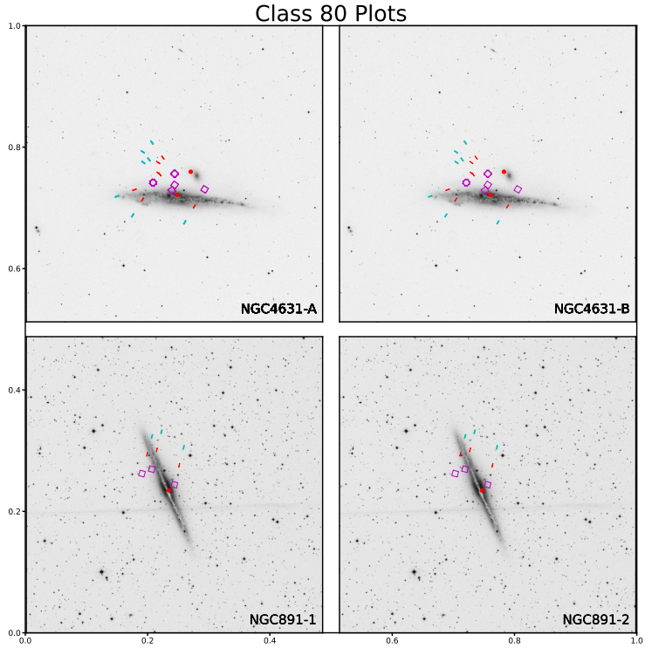
Plots!
Manual + Automatic search routine.
Overlay FUSE pointings onto the field, using DSS images.
Colors represent the exact location of each aperture.
Begin trimming the amount of observations, discarding exposures that are unlikely to yield a result.

Slide 5
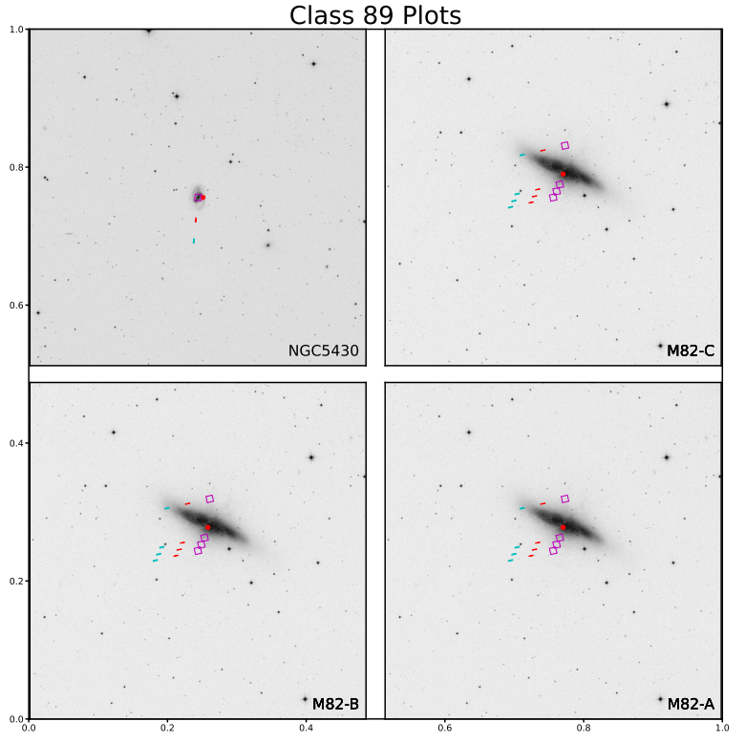
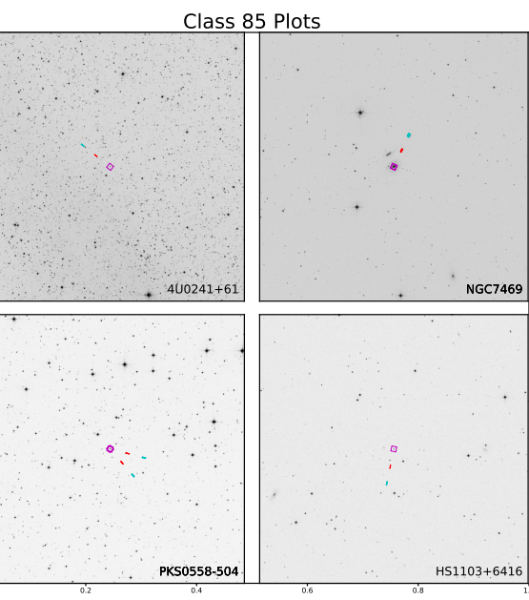
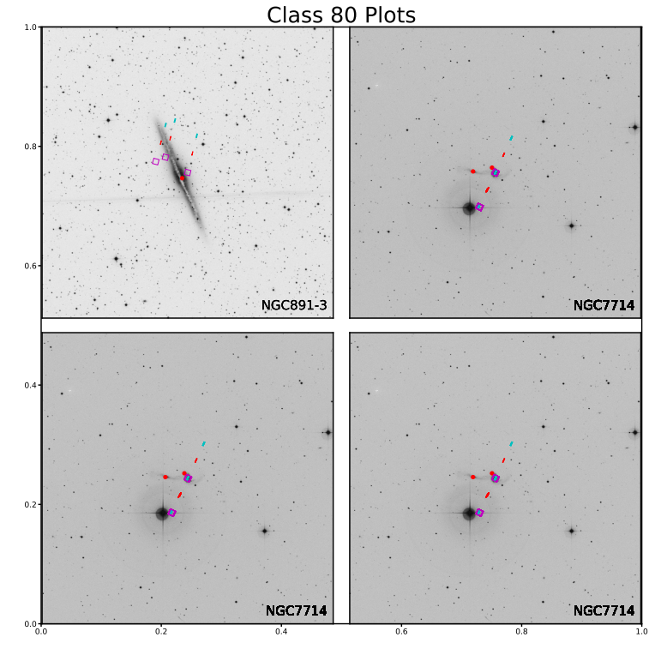
Plots!
Iterated through by object classification, 100 classes.
Some object classes have no chance at containing the signal.
Class 54 in the middle have a low chance at containing the O-VI signal within their spectra.
Class 80 objects are of high interest, none will be discarded.
Class 89: Starburst Galaxies (useful)
Class 85: Quasars (not useful)
Class 80: Spiral Galaxies (useful)

Slide 6
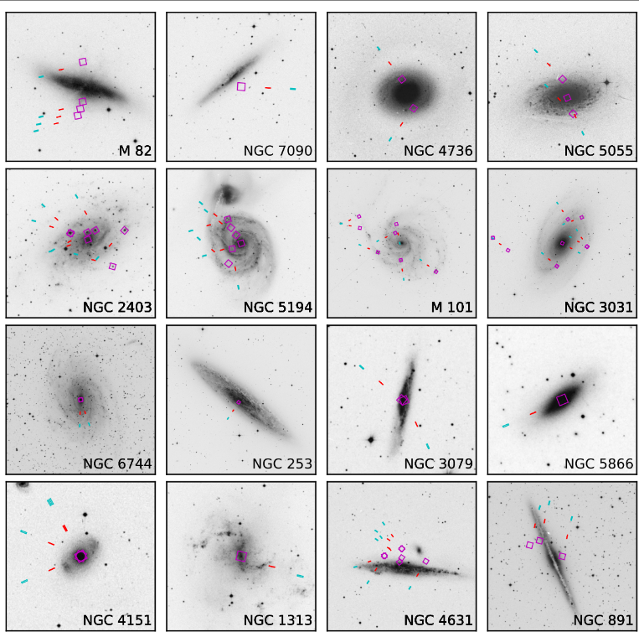
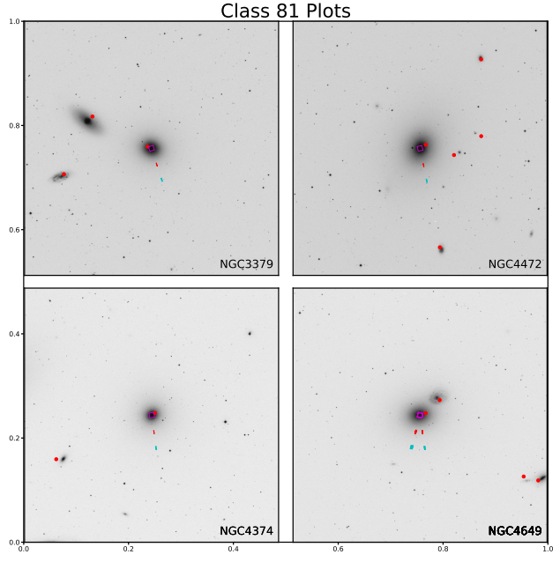



Plots!
Class 81: Elliptical Galaxies (useful)

Slide 7
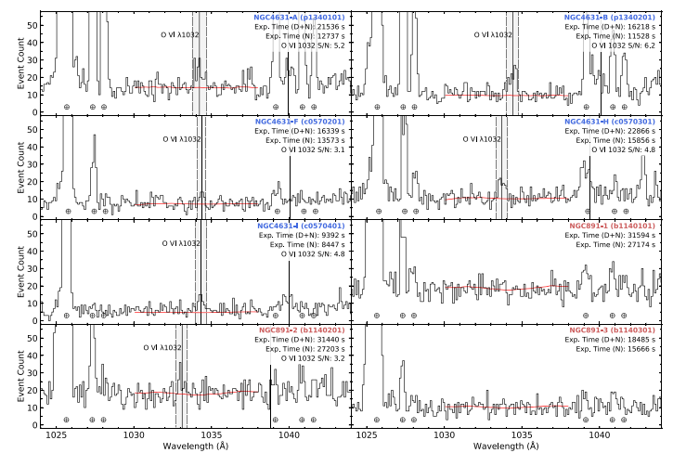
Spectra
CALFUSE - A combined C/Fortran data reduction pipeline specifically for FUSE.
Last updated in 2008, built to run on Linux/Solaris systems only.
Very sensitive to parameters use during reduction.
Signal is compared to background, and a hit is defined to 3σ confidence.
Loop through every observation id, removing the discarded exposures.
Credit: Chung 2021

Slide 8
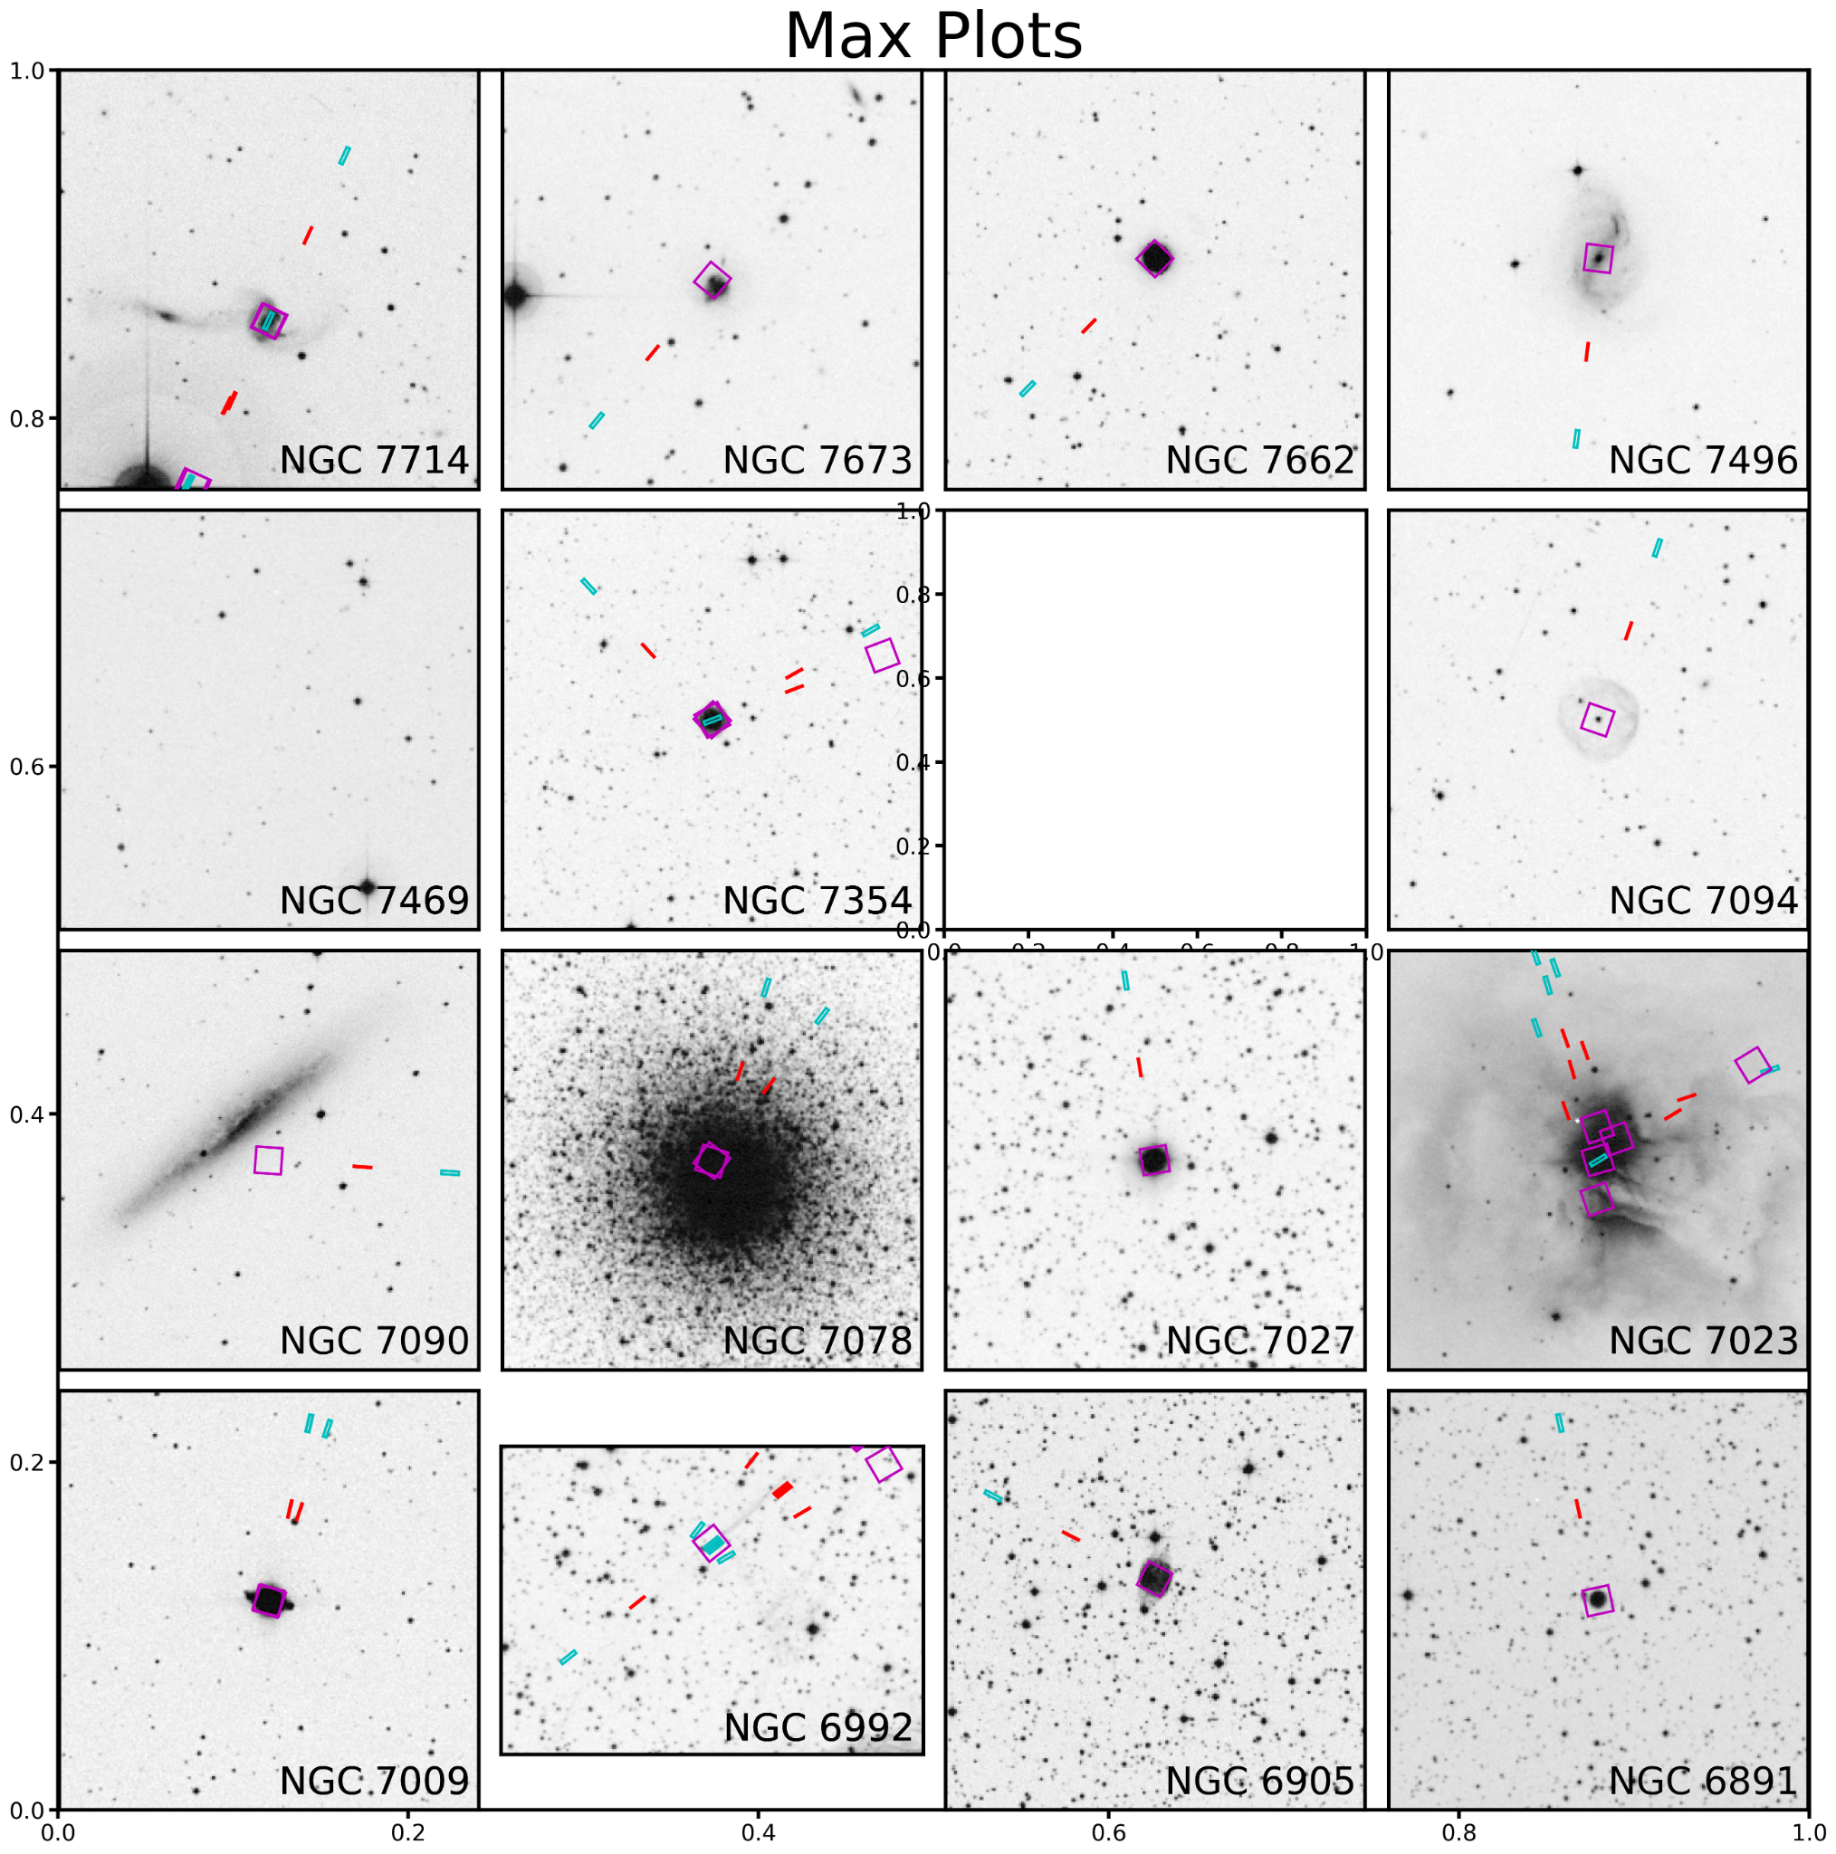
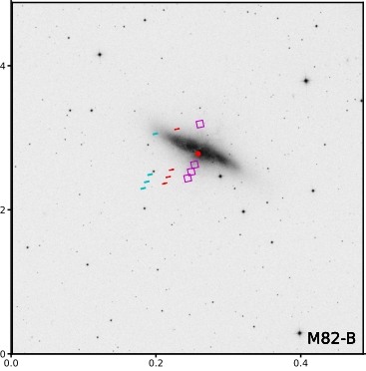
Results
Full Spectral analysis of catalog still in process.
Plan to verify the previous 2 known detections, while hopefully finding more.
Set baselines on every target observed by FUSE, to be used by ASPERA.

Slide 9
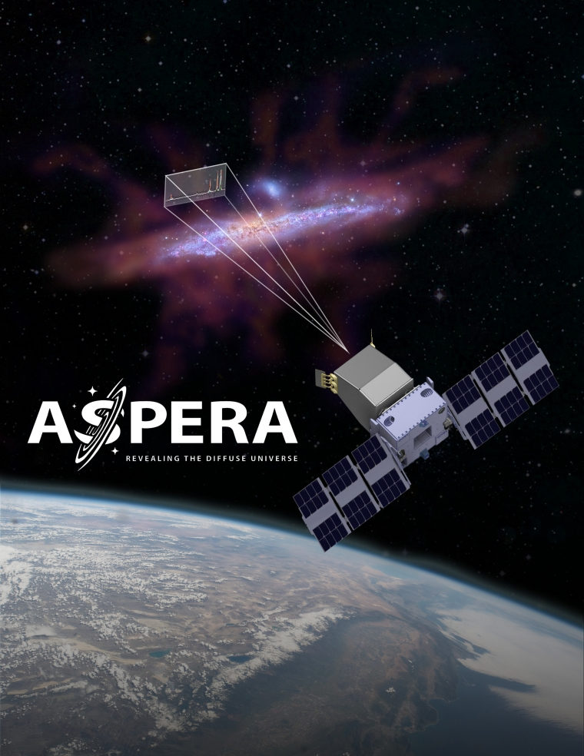
ASPERA Mission
Another FUV spectroscopic satellite to be launched in the next 2-4 years.
About twice as sensitive than FUSE to O-VI signal.
Seeks to dramatically increase the amount of O-VI detections.
Further constrain CGM behavior and evolution.

Slide 10
Acknowledgements
Dr. Haeun Chung, Research Advisor
Dr. Carlos Vargas, Principal Investigator of ASPERA
Arizona Space Grant Consortium
University of Arizona Astronomy, Physics

Slide 11
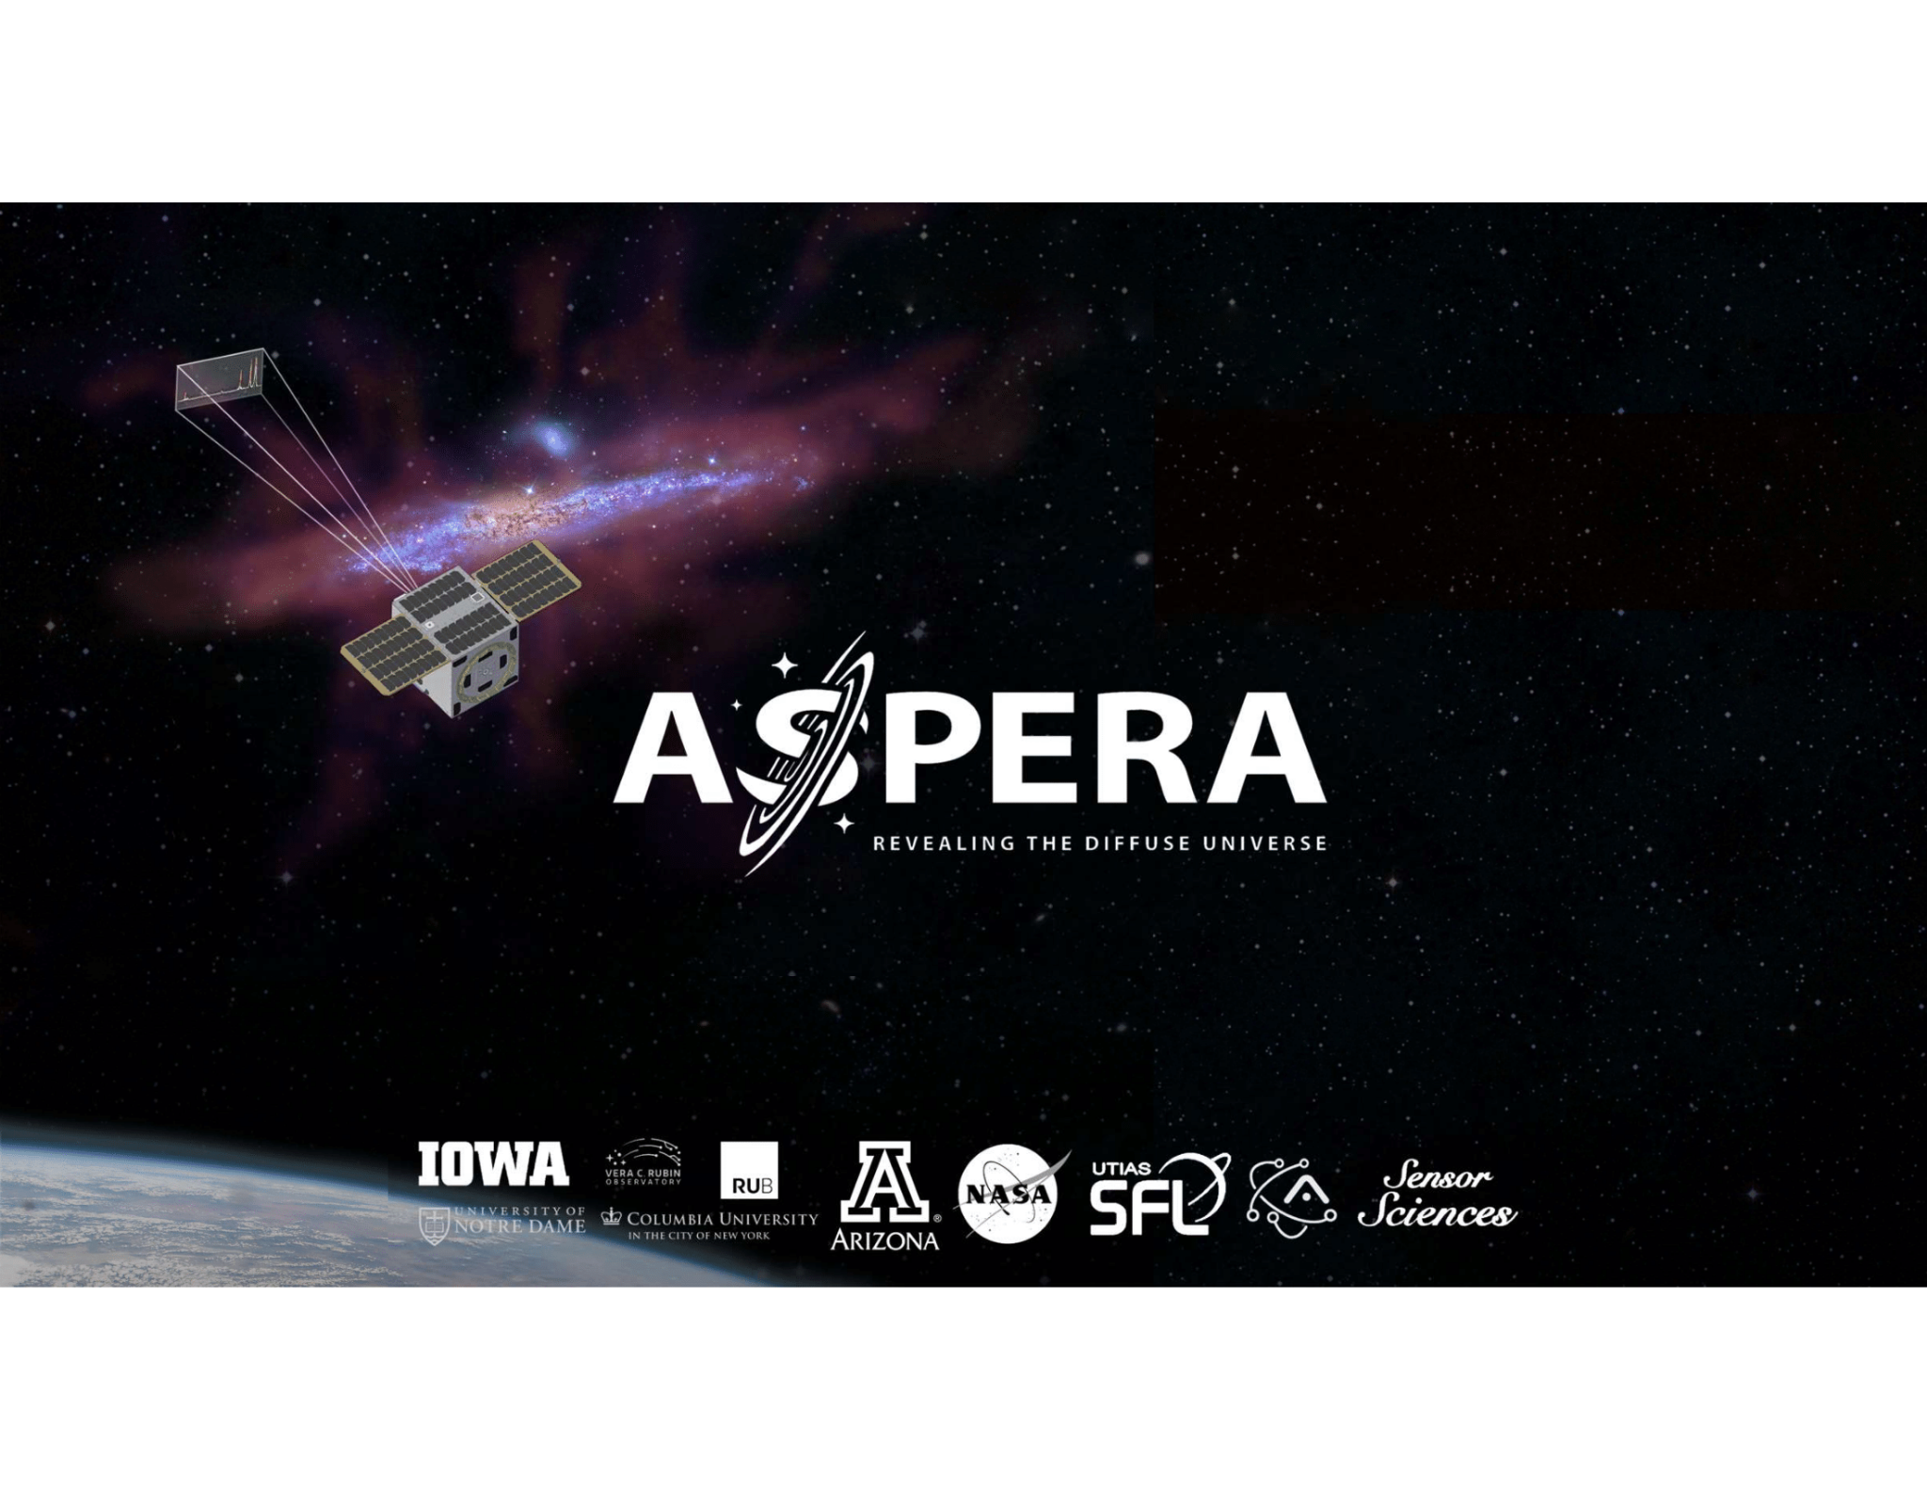
Thank You!

